Slide 1

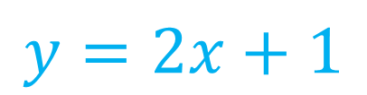


Algebra Interactive Notebook
$$3ab$$
$$\frac{5xy}{6}$$
Name :
Class :
Term 1 Semester 1
$$2x+3y$$
$$y=2x+1$$

Slide 2
Contents
Glossary
Page
Date
Description
2
3

Slide 3
Tasks
24
7
30
Essential Question
Questions
Notes
Summary
4
7

Slide 4
Simplifying Expressions
24
7
30
EQ: What is a ‘like term’ and how do I collect them?

Slide 5
Math Jokes of the day
Parallel lines have so much in common... it’s a shame they’ll never meet!
Q: How can you make seven an even number? A: Take the 's' out!
Q: Why is a math book depressed? A: Because it has so many problems.
There was a statistician that drowned trying to cross a river... it was three feet deep, on average.
How do you stay warm in an empty room? Go into the corner where it is always 90 degrees.
There are three kinds of people in the world: those who can count and those who can't.
Q: How do you know your math tutor is hungry? A: She'll work for pi.

Slide 6

Simplifying Expressions
24
7
30
EQ: What is a ‘like term’ and how do I collect them?
Glossary terms
constant
variable
coefficient
A number with nothing else attached to it
Eg: $1, 2, 5, 47, 936$
A letter that represents an unknown number
Eg: $a, b, x, y$
The number in front of the variable
Eg: $3x 3 is the coefficient$
$5y 5 is the coefficient$

Slide 7

Simplifying Expressions
24
7
30
EQ: What is a ‘like term’ and how do I collect them?
What is a like term?
Like terms are the terms that have the same variables
$3x 5y 7xy 4x 6y 3yx 8y$
Group the above into ‘like terms’:
$$3x, 4x$$
$$5y, 6y, 8y$$
$7xy, 3yx$ $7xy, 3xy$ ALWAYS IN ALPHABETICAL ORDER!

Slide 8
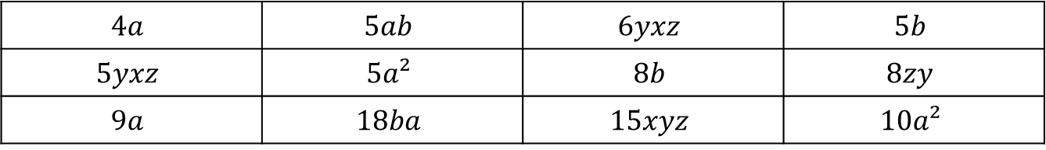
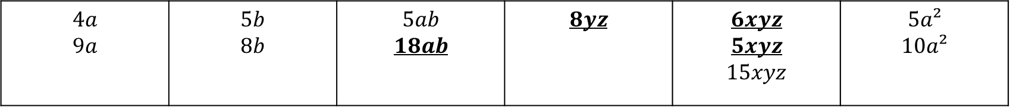
Practice: lhs
GROUP THE FOLLOWING INTO LIKE TERMS
$$4a$$ | $$5ab$$ | $$6yxz$$ | $$5b$$
$$5yxz$$ | $$5a²$$ | $$8b$$ | $$8zy$$
$$9a$$ | $$18ba$$ | $$15xyz$$ | $$10a²$$
$$4a$$ $$9a$$ | $$5b$$ $$8b$$ | $$5ab$$ $$18ab$$ | $$8yz$$ | $$6xyz$$ $$5xyz$$ $$15xyz$$ | $$5a²$$ $$10a²$$

Slide 9
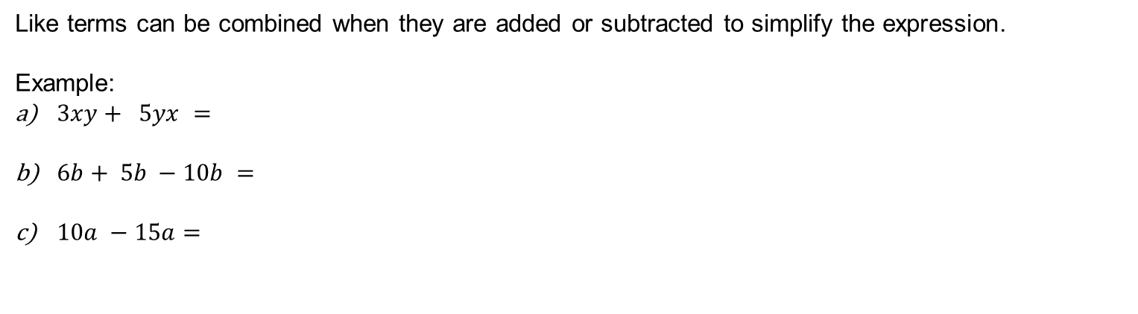
Simplifying Expressions
24
7
30
EQ: What is a ‘like term’ and how do I collect them?
How do I add and subtract like terms?
Like terms can be combined when they are added or subtracted to simplify the expression.
Example:
$3xy+ 5yx =$
$6b+ 5b −10b =$
$10a −15a=$

Slide 10
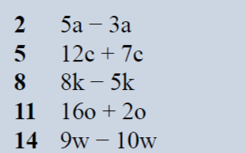
Practice: lhs
2a
19c
3k
18o
-w

Slide 11

Simplifying Expressions
24
7
30
EQ: What is a ‘like term’ and how do I collect them?
How do I add and subtract like terms?
Like terms can be combined when they are added or subtracted to simplify the expression.
Example:
$3xy+ 5xy =$
$6b+ 5b −10b =$
$10a −15a=$
$3x+7y −2x +3y=$

Slide 12


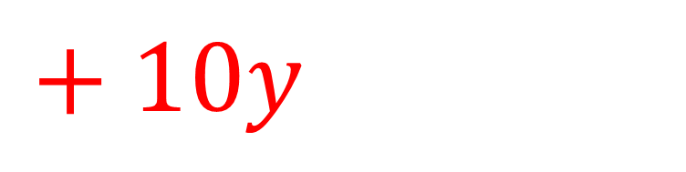
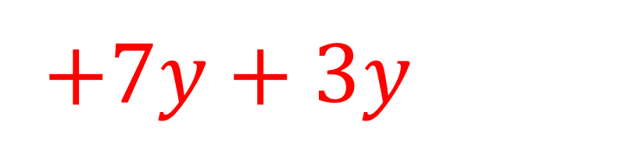

$$3x+7y −2x +3y$$
$$3x−2x$$
$+7y+3y$
$x$
$+ 10y$

Slide 13
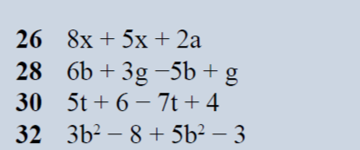

Practice: lhs
$13x+2a$
$$b + 4g$$
$$−2t+10$$
$$8b^{2}−11$$

Slide 14
Task

Slide 15
Answers

Slide 16
EXIT pASS
Place FIVE PROBLEMS ON THE BOARD AND HAVE YOUR WONDERFUL STUDENTS ANSWER THEM.

